Slide 1
Hierarchical Clustering
Ross Morton

Slide 2
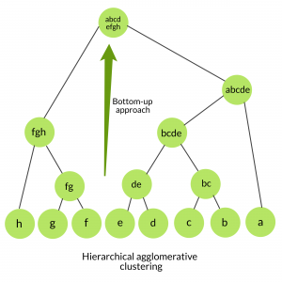
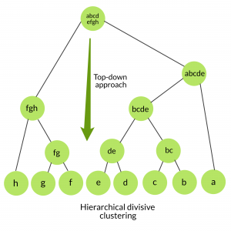
Hierarchical Clustering
Introduction
Exploratory/Unsupervised learning and is used for clustering population into different groups.
Clustered groups can then be treated differently (i.e. different customer groups)
Agglomerative Clustering
AGNES - (Agglomerative Nesting)
Divisive Hierarchical Clustering
DIANA - (Divisive Analysis)
https://www.geeksforgeeks.org/ml-hierarchical-clustering-agglomerative-and-divisive-clustering/

Slide 3
Hierarchical Clustering
Method
High Level Steps (Agglomerative):
Take each point is its own cluster
Take closest data points and make one cluster.
Various Distance based methods - mean , minimum, average, centroid etc.
Creates a proximity matrix to determine closest clusters
Repeat until only one cluster if left.
Creates a Dendrogram-
Vertical lines denominates the distance between clusters and can be used to determine number of clusters required.
Strength -
Do not need to know the number of clusters prior to running
Weakness-
Poor with large data sets (time intensive)
Agglomerative Hierarchical Clustering
AGNES
https://dashee87.github.io/data%20science/general/Clustering-with-Scikit-with-GIFs/

